Slide 1
Iota Gamma Directory Conversion Project
Progress Report as of 3 Feb 2018
Working Group 4 Peter Palmisano, Instructor
Sue Argentieri | Luis Sanchez-Artu | Peres Doubeni | Ingrid Henricksen
Notes:
We are now ending the design phase of the project and beginning the development phase.

Slide 2


Business Case: The Organization
Notes:
A reminder of the project plan – convert a directory that was kept on a spreadsheet to a database that can be accessed by members of the chapter.

Slide 3
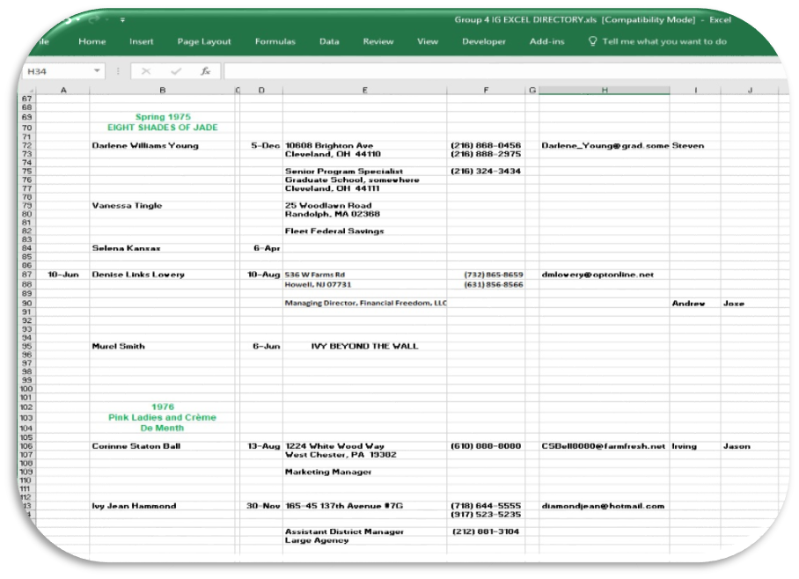
Reminder of the Problems
Managed by one person
More data to enter
Transmitted via email
Multiple copies
Data lacks integrity
Not easily searchable
Not secure
Notes:
This is necessary because one person was maintaining the directory on her home computer.

Slide 4
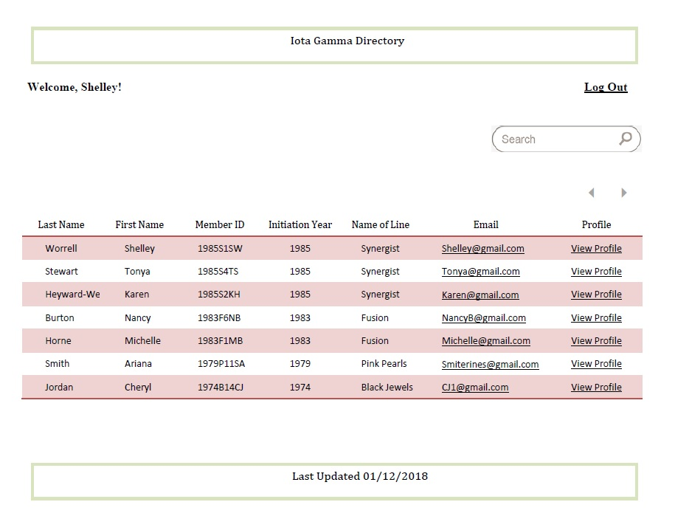

The proposed Solution
Database - central
repository
ACL list –all users log in
Searchable
Improved data quality
Notes:
This is directly from our wireframe

Slide 5
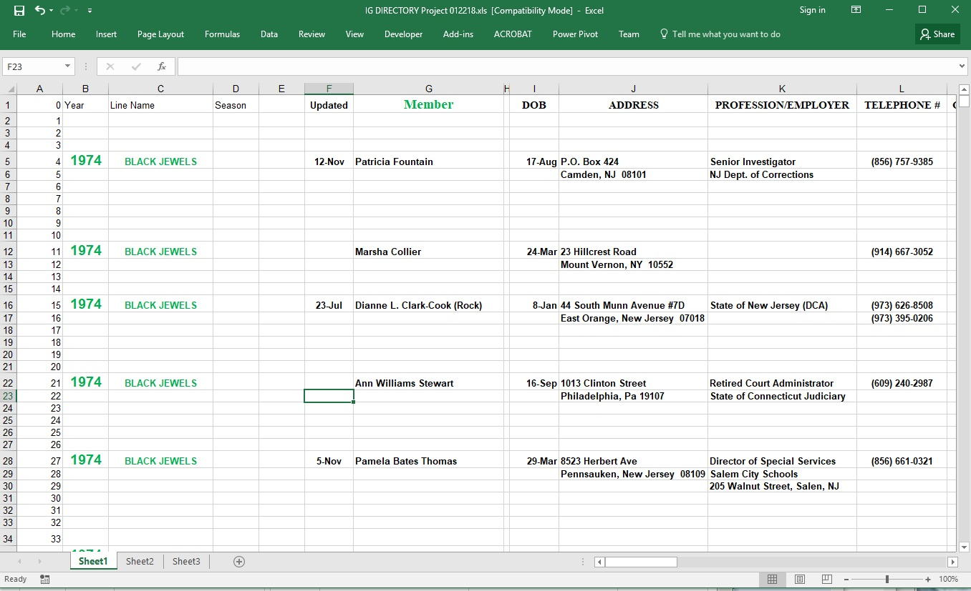
Data Modified
Data scrubbing has begun…
Notes:
Although there were 1173 lines used on the Excel spreadsheet, there are only 201 members in the list, there is lots of white space. Some of the data scrubbing has begun.

Slide 6
The Original Schedule
Target Date | Major Milestones
January 26, 2018 | Designs Complete
March 2, 2018 | Product Development Complete
March 23, 2018 | Business Data Migration & Module Testing Complete
April 6, 2018 | System Launch
April 14, 2018 | End-User Training Complete
April 27, 2018 | Project Closure

Slide 7
Critical tasks adjusted for slippage
Name | Start | Finish | % Complete
Define Use Cases | Mon 1/8/18 | Mon 2/5/18 | 95%
Standardize scripting nomenclature | Wed 2/7/18 | Thu 2/8/18 | 75%
Define class domains | Thu 2/8/18 | Fri 2/9/18 | 90%
DB module test | Mon 3/5/18 | Fri 3/9/18 | 0%
UI module test | Mon 3/5/18 | Fri 3/9/18 | 0%
Perform system-integration test | Mon 3/12/18 | Fri 3/16/18 | 0%
Normalize data | Mon 3/19/18 | Wed 3/21/18 | 15%
Upload current data into new system | Thu 3/22/18 | Fri 3/23/18 | 0%
Perform user-acceptance test | Mon 3/26/18 | Fri 3/30/18 | 0%
Launch system | Mon 4/2/18 | Thu 4/5/18 | 0%
Plan training | Fri 4/6/18 | Mon 4/9/18 | 0%
Create training materials | Tue 4/10/18 | Wed 4/11/18 | 0%
Hold training session | Thu 4/12/18 | Fri 4/13/18 | 0%
Document lessons learned | Mon 4/16/18 | Fri 4/20/18 | 0%
Archive/transition project documentation | Mon 4/23/18 | Thu 4/26/18 | 0%
Sign project closure document | Fri 4/27/18 | Fri 4/27/18 | 0%
Notes:
Still completed on time.

